Slide 1
Understanding the Physics of Doppler
Week 13

Slide 2

Doppler Physics
Doppler effect
Doppler equation
Doppler Modes
Doppler Artifacts

Slide 3
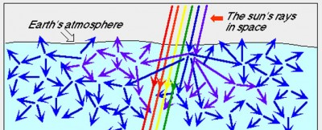
Scattering of Ultrasound by RBC's
Named after the British Physicist – Lord Rayleigh
The predominantly elastic scattering of light or other electromagnetic radiation by particles much smaller than the wavelength of the radiation
Red blood cells
Diameter: 7µm
Smaller than ultrasound wavelength (0.1-0.7 mm)

Slide 4

Scattering of Ultrasound by RBC's
The intensity of the Rayleigh scatterers is determined by:
Transducer frequency
Scatterer density
Scatterer size
Scatterer acoustic impedance

Slide 5
The Doppler Effect
Doppler shift is a change in frequency caused by the relative movement of the sound source or the reflector.
The transducer is the sound wave source.
Red blood cells are the reflector.
RBC’s can be:
Stationary
Moving towards the transducer
Moving away from the transducer
Notes:
The Doppler Effect
A change in frequency caused by the movement of either the sound wave source or the sound wave receiver.
[Example]
Discuss the Doppler effect. A change in the frequency of sound that results from motion between the source of the sound wave and its receiver.

Slide 6
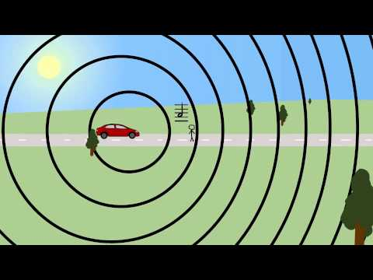
The Doppler Effect

Slide 7

Doppler Equation
f_{d} =
2f₀vcosθ
c
f_{d} = Doppler shifted frequency
f_{o} = transducer frequency
v = blood velocity
cosO = beam flow angle
c = speed of sound in tissue (1540 m/s)

Slide 8
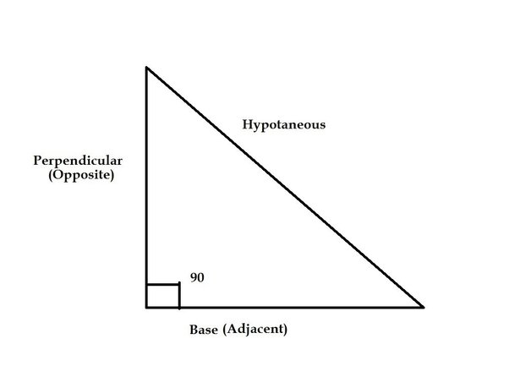
Cos θ - the ratio of the adjacent side of an angle and the hypotenuse of the triangle
1.00
Cos θ
0
θ
90

Slide 9
Angle to Flow
Angle | Cosine
0 | 1.00
15 | 0.97
45 | 0.71
60 | 0.50
75 | 0.26
90 | 0.00

Slide 10
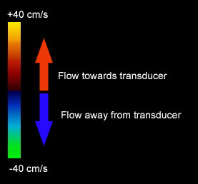
Beam Flow Angle
Ø = 0°
Parallel to flow - Optimum shift
Ø = 1° to 89°
Shift is reduced
Ø = 90°
Perpendicular to flow - No shift
Notes:
The Cosine Relationship
COS θ
-Beam parallel to flow
-COS 0° = 1, optimum sensitivity
-Beam perpendicular to flow
-COS 90° = 0, no sensitivity
[Review: Define cosine and its importance in Doppler.]
[Example]
If sound beam was propagated at the same angle as the blood flow, the COSθ would be 1 and there would be maximum velocity sensitivity. If the sound beam-to-blood flow angle is between a 1 and 89 degree angle, the detected Doppler frequency shift is reduced according to the cosθ term. If the beam is perpendicular, or 90 degrees to the flow, the cosθis 0 and there will be no detected Doppler shift. This demonstrates how important it is to have a good Doppler angle to the blood flow.
Note: When a sonographer wishes to identify the presence of flow, this interdependence of flow and the cosine is unimportant (as long as the incident angle is something other than 90 degrees).

Slide 11
Beam Flow Angle
Best Doppler angle is parallel to flow and closest to 0°
Angle is affected by
organ position
patient position
transducer position
Notes:
Doppler Principles
Angle to Flow
Best Doppler angle is parallel to flow and closest to zero degrees
Transducer position
Patient position
Remember that in order to get your best Doppler information, in color, just as in spectral Doppler, you must optimize your angle to flow. Again, the best Doppler is parallel to flow or at angles closest to zero degrees. You can use transducer position or steering with linear transducers and patient position to help achieve the best angle.

Slide 12
Doppler Modes
Pulsed Wave Doppler
Continuous Wave Doppler
Color Doppler
Power Doppler
Notes:
Spectral Doppler Modes
Pulsed Wave Doppler
Continuous Wave Doppler (with cardiac option)
In Pulsed Wave and Continuous Wave Doppler, you select the area of interest by positioning a Doppler cursor within the 2-D image. Pulsed Wave Doppler displays velocities within the range bounded by the Doppler gate on the cursor. Both let you simultaneously display the 2-D image and Doppler spectral information or independently display spectral Doppler information.
Auxiliary Continuous Wave Doppler (with cardiac option)
Auxiliary Continuous Wave Doppler uses a special auxiliary transducer. Because of its small size, the auxiliary transducer can access any area requiring documentation of blood flow. You position the auxiliary transducer independently of the transducer you are using for the 2-D image. Auxiliary Continuous Wave Doppler displays only a full-screen spectral display.
HPRF (High Pulse Repetition Frequency)
High Pulse Repetition Frequency (HPRF) allows increased velocity detection at depth and localization of flow. Use HPRF Pulsed Doppler mode when you want the Doppler velocity scale higher than the system can provide in standard Pulsed Doppler mode at a specific gate depth. HPRF generates multiple sample volumes displayed with smaller secondary gates in addition to the standard gate size of the primary sample volume. Excellent Sensitivity.

Slide 13
Pulsed Doppler
A
C
A = PRP
B = Pulse Duration
C= Reception Time
B
Notes:
A: PRP includes the “on and off” time. Adjustable by the sonographer when the depth of view is changed. Units of time, such as ms. Determined by the “sound source” only. Typical values 100 microseconds to 1 millisecond. Unrelated to period!
B: PD is the “on” or “talking” time only. Units of time, such as ms, Typical values of 0.3-2.0 milliseconds. Determined by the “sound source” only! Is not adjustable by sonographer.
C: Reception time is the “off” or “listening” time only! Sonographer cannot change!

Slide 14
Pulsed Doppler
Pulsed Duration = period x cycles per pulse
PRP = PD + Reception Time
PRF = # of pulses per second
PRP = 1/PRF
Duty Factor = PD
PRP
Notes:
PRF: Is the # of pulses emitted into the body per second via the U/S system Units is Hertz (Hz), or per second. Determined by the “sound source” only. Adjustable by the sonographer by adjusting the depth of view. Typical values is 1,000 to 10,000 Hz or 1-10 thousand pulses per second
DF: Is the % or fraction of time that the system transmits a pulse. Determined by the “sound source” only! Adjustable by the sonographer changes the depth of view! Inversely related to the imaging depth. DF is increased at shallow depths and decreased at greater depths.

Slide 15

Range Equation
The relationship between round-trip pulse travel time, propagation speed, and distance to a reflector
Time that can be measured is the go – return time.
The actual time = go - return time
2
Notes:
The time needed for a pulse to travel “to and from” the transducer and the reflector.
In soft tissue, every 13 microseconds of “go-return” time means the reflector is 1cm deeper in the body. Page 51 in ESP physics book!

Slide 16
Range Equation
Reflector distance = velocity x go-return time
2
Notes:
The time needed for a pulse to travel “to and from” the transducer and the reflector.
In soft tissue, every 13 microseconds of “go-return” time means the reflector is 1cm deeper in the body. Page 51 in ESP physics book!

Slide 17
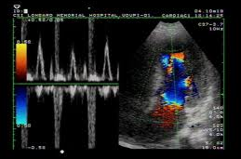
Aliasing
The inability of a PD transducer to detect large Doppler shift is known as aliasing.

Slide 18
Aliasing
The sampling rate = PRF
Maximum PRF is determined by the go - return time or depth of image.
Deeper vessels requires longer go-return time and thus a lower PRF.

Slide 19
Pulsed Doppler
Receiver Gated
Receiver circuits only open for a short interval during every pulse cycle.

Slide 20
Pulsed Doppler
Receiver Gated
Receiver circuits only open for a short interval during every pulse cycle.

Slide 21
Spectral Analysis
The component frequencies are converted into velocity information.
This allows for quantitative analysis of the range of RBC’s velocities.
Notes:
Spectral Doppler Modes
Pulsed Wave Doppler
Continuous Wave Doppler (with cardiac option)
In Pulsed Wave and Continuous Wave Doppler, you select the area of interest by positioning a Doppler cursor within the 2-D image. Pulsed Wave Doppler displays velocities within the range bounded by the Doppler gate on the cursor. Both let you simultaneously display the 2-D image and Doppler spectral information or independently display spectral Doppler information.
Auxiliary Continuous Wave Doppler (with cardiac option)
Auxiliary Continuous Wave Doppler uses a special auxiliary transducer. Because of its small size, the auxiliary transducer can access any area requiring documentation of blood flow. You position the auxiliary transducer independently of the transducer you are using for the 2-D image. Auxiliary Continuous Wave Doppler displays only a full-screen spectral display.
HPRF (High Pulse Repetition Frequency)
High Pulse Repetition Frequency (HPRF) allows increased velocity detection at depth and localization of flow. Use HPRF Pulsed Doppler mode when you want the Doppler velocity scale higher than the system can provide in standard Pulsed Doppler mode at a specific gate depth. HPRF generates multiple sample volumes displayed with smaller secondary gates in addition to the standard gate size of the primary sample volume. Excellent Sensitivity.

Slide 22
Spectral Display
Doppler Signals
Analysis
FFT
Quadrature Phase
Detector
Positive
Shift
Negative
Shift
Channel A
Channel B
Audio Channel A
Audio Channel B
Spectral Display
Below the Baseline
Spectral Display
Above the Baseline
Notes:
Spectral Doppler Modes
Pulsed Wave Doppler
Continuous Wave Doppler (with cardiac option)
In Pulsed Wave and Continuous Wave Doppler, you select the area of interest by positioning a Doppler cursor within the 2-D image. Pulsed Wave Doppler displays velocities within the range bounded by the Doppler gate on the cursor. Both let you simultaneously display the 2-D image and Doppler spectral information or independently display spectral Doppler information.
Auxiliary Continuous Wave Doppler (with cardiac option)
Auxiliary Continuous Wave Doppler uses a special auxiliary transducer. Because of its small size, the auxiliary transducer can access any area requiring documentation of blood flow. You position the auxiliary transducer independently of the transducer you are using for the 2-D image. Auxiliary Continuous Wave Doppler displays only a full-screen spectral display.
HPRF (High Pulse Repetition Frequency)
High Pulse Repetition Frequency (HPRF) allows increased velocity detection at depth and localization of flow. Use HPRF Pulsed Doppler mode when you want the Doppler velocity scale higher than the system can provide in standard Pulsed Doppler mode at a specific gate depth. HPRF generates multiple sample volumes displayed with smaller secondary gates in addition to the standard gate size of the primary sample volume. Excellent Sensitivity.

Slide 23
Spectral Display
X- axis : time information
Y- axis : frequency/velocity information.
Z- axis : amplitude information.
Notes:
Spectral Doppler Modes
Pulsed Wave Doppler
Continuous Wave Doppler (with cardiac option)
In Pulsed Wave and Continuous Wave Doppler, you select the area of interest by positioning a Doppler cursor within the 2-D image. Pulsed Wave Doppler displays velocities within the range bounded by the Doppler gate on the cursor. Both let you simultaneously display the 2-D image and Doppler spectral information or independently display spectral Doppler information.
Auxiliary Continuous Wave Doppler (with cardiac option)
Auxiliary Continuous Wave Doppler uses a special auxiliary transducer. Because of its small size, the auxiliary transducer can access any area requiring documentation of blood flow. You position the auxiliary transducer independently of the transducer you are using for the 2-D image. Auxiliary Continuous Wave Doppler displays only a full-screen spectral display.
HPRF (High Pulse Repetition Frequency)
High Pulse Repetition Frequency (HPRF) allows increased velocity detection at depth and localization of flow. Use HPRF Pulsed Doppler mode when you want the Doppler velocity scale higher than the system can provide in standard Pulsed Doppler mode at a specific gate depth. HPRF generates multiple sample volumes displayed with smaller secondary gates in addition to the standard gate size of the primary sample volume. Excellent Sensitivity.

Slide 24
Spectral Display
Frequency,
y-axis
Amplitude
Z- axis
Sonic Window
Time, x axis
Notes:
Spectral Doppler Modes
Pulsed Wave Doppler
Continuous Wave Doppler (with cardiac option)
In Pulsed Wave and Continuous Wave Doppler, you select the area of interest by positioning a Doppler cursor within the 2-D image. Pulsed Wave Doppler displays velocities within the range bounded by the Doppler gate on the cursor. Both let you simultaneously display the 2-D image and Doppler spectral information or independently display spectral Doppler information.
Auxiliary Continuous Wave Doppler (with cardiac option)
Auxiliary Continuous Wave Doppler uses a special auxiliary transducer. Because of its small size, the auxiliary transducer can access any area requiring documentation of blood flow. You position the auxiliary transducer independently of the transducer you are using for the 2-D image. Auxiliary Continuous Wave Doppler displays only a full-screen spectral display.
HPRF (High Pulse Repetition Frequency)
High Pulse Repetition Frequency (HPRF) allows increased velocity detection at depth and localization of flow. Use HPRF Pulsed Doppler mode when you want the Doppler velocity scale higher than the system can provide in standard Pulsed Doppler mode at a specific gate depth. HPRF generates multiple sample volumes displayed with smaller secondary gates in addition to the standard gate size of the primary sample volume. Excellent Sensitivity.

Slide 25
Spectral Display
Velocity Measurements
Peak systolic velocity
End-diastolic velocity
Mean velocity – calculated by taken the area under the curve.
Notes:
Spectral Doppler Modes
Pulsed Wave Doppler
Continuous Wave Doppler (with cardiac option)
In Pulsed Wave and Continuous Wave Doppler, you select the area of interest by positioning a Doppler cursor within the 2-D image. Pulsed Wave Doppler displays velocities within the range bounded by the Doppler gate on the cursor. Both let you simultaneously display the 2-D image and Doppler spectral information or independently display spectral Doppler information.
Auxiliary Continuous Wave Doppler (with cardiac option)
Auxiliary Continuous Wave Doppler uses a special auxiliary transducer. Because of its small size, the auxiliary transducer can access any area requiring documentation of blood flow. You position the auxiliary transducer independently of the transducer you are using for the 2-D image. Auxiliary Continuous Wave Doppler displays only a full-screen spectral display.
HPRF (High Pulse Repetition Frequency)
High Pulse Repetition Frequency (HPRF) allows increased velocity detection at depth and localization of flow. Use HPRF Pulsed Doppler mode when you want the Doppler velocity scale higher than the system can provide in standard Pulsed Doppler mode at a specific gate depth. HPRF generates multiple sample volumes displayed with smaller secondary gates in addition to the standard gate size of the primary sample volume. Excellent Sensitivity.

Slide 26
Spectral Display
Systolic Peak
Velocity
Velocity
Mean Velocity
End Diastolic Velocity
Time
Notes:
Spectral Doppler Modes
Pulsed Wave Doppler
Continuous Wave Doppler (with cardiac option)
In Pulsed Wave and Continuous Wave Doppler, you select the area of interest by positioning a Doppler cursor within the 2-D image. Pulsed Wave Doppler displays velocities within the range bounded by the Doppler gate on the cursor. Both let you simultaneously display the 2-D image and Doppler spectral information or independently display spectral Doppler information.
Auxiliary Continuous Wave Doppler (with cardiac option)
Auxiliary Continuous Wave Doppler uses a special auxiliary transducer. Because of its small size, the auxiliary transducer can access any area requiring documentation of blood flow. You position the auxiliary transducer independently of the transducer you are using for the 2-D image. Auxiliary Continuous Wave Doppler displays only a full-screen spectral display.
HPRF (High Pulse Repetition Frequency)
High Pulse Repetition Frequency (HPRF) allows increased velocity detection at depth and localization of flow. Use HPRF Pulsed Doppler mode when you want the Doppler velocity scale higher than the system can provide in standard Pulsed Doppler mode at a specific gate depth. HPRF generates multiple sample volumes displayed with smaller secondary gates in addition to the standard gate size of the primary sample volume. Excellent Sensitivity.

Slide 27
Doppler Spectrum Assessment
Assess the following:
Presence of flow
Direction of flow
Amplitude
Window
Pulsatility
Notes:
Spectral Doppler Modes
Pulsed Wave Doppler
Continuous Wave Doppler (with cardiac option)
In Pulsed Wave and Continuous Wave Doppler, you select the area of interest by positioning a Doppler cursor within the 2-D image. Pulsed Wave Doppler displays velocities within the range bounded by the Doppler gate on the cursor. Both let you simultaneously display the 2-D image and Doppler spectral information or independently display spectral Doppler information.
Auxiliary Continuous Wave Doppler (with cardiac option)
Auxiliary Continuous Wave Doppler uses a special auxiliary transducer. Because of its small size, the auxiliary transducer can access any area requiring documentation of blood flow. You position the auxiliary transducer independently of the transducer you are using for the 2-D image. Auxiliary Continuous Wave Doppler displays only a full-screen spectral display.
HPRF (High Pulse Repetition Frequency)
High Pulse Repetition Frequency (HPRF) allows increased velocity detection at depth and localization of flow. Use HPRF Pulsed Doppler mode when you want the Doppler velocity scale higher than the system can provide in standard Pulsed Doppler mode at a specific gate depth. HPRF generates multiple sample volumes displayed with smaller secondary gates in addition to the standard gate size of the primary sample volume. Excellent Sensitivity.

Slide 28
Doppler Spectrum Assessment
Check for Flow
Flow
Detected
No Flow
Detected
Check
Sensitivity
Check
SV Placement
Check Beam-
flow angle
Sensitive
Decreased
Sensitivity
Improve
Sensitivity
Notes:
Spectral Doppler Modes
Pulsed Wave Doppler
Continuous Wave Doppler (with cardiac option)
In Pulsed Wave and Continuous Wave Doppler, you select the area of interest by positioning a Doppler cursor within the 2-D image. Pulsed Wave Doppler displays velocities within the range bounded by the Doppler gate on the cursor. Both let you simultaneously display the 2-D image and Doppler spectral information or independently display spectral Doppler information.
Auxiliary Continuous Wave Doppler (with cardiac option)
Auxiliary Continuous Wave Doppler uses a special auxiliary transducer. Because of its small size, the auxiliary transducer can access any area requiring documentation of blood flow. You position the auxiliary transducer independently of the transducer you are using for the 2-D image. Auxiliary Continuous Wave Doppler displays only a full-screen spectral display.
HPRF (High Pulse Repetition Frequency)
High Pulse Repetition Frequency (HPRF) allows increased velocity detection at depth and localization of flow. Use HPRF Pulsed Doppler mode when you want the Doppler velocity scale higher than the system can provide in standard Pulsed Doppler mode at a specific gate depth. HPRF generates multiple sample volumes displayed with smaller secondary gates in addition to the standard gate size of the primary sample volume. Excellent Sensitivity.

Slide 29
Doppler Spectrum Assessment
Sensitivity can be improved by:
Increasing power or gain.
Decreasing the velocity scale.
Decreasing the reject or filter.
Slowly increasing the SV size.
Notes:
Spectral Doppler Modes
Pulsed Wave Doppler
Continuous Wave Doppler (with cardiac option)
In Pulsed Wave and Continuous Wave Doppler, you select the area of interest by positioning a Doppler cursor within the 2-D image. Pulsed Wave Doppler displays velocities within the range bounded by the Doppler gate on the cursor. Both let you simultaneously display the 2-D image and Doppler spectral information or independently display spectral Doppler information.
Auxiliary Continuous Wave Doppler (with cardiac option)
Auxiliary Continuous Wave Doppler uses a special auxiliary transducer. Because of its small size, the auxiliary transducer can access any area requiring documentation of blood flow. You position the auxiliary transducer independently of the transducer you are using for the 2-D image. Auxiliary Continuous Wave Doppler displays only a full-screen spectral display.
HPRF (High Pulse Repetition Frequency)
High Pulse Repetition Frequency (HPRF) allows increased velocity detection at depth and localization of flow. Use HPRF Pulsed Doppler mode when you want the Doppler velocity scale higher than the system can provide in standard Pulsed Doppler mode at a specific gate depth. HPRF generates multiple sample volumes displayed with smaller secondary gates in addition to the standard gate size of the primary sample volume. Excellent Sensitivity.

Slide 30
Doppler Spectrum Assessment
Flow can either be:
Mono-phasic
Bi-phasic
Tri-phasic
Bidirectional
Notes:
Spectral Doppler Modes
Pulsed Wave Doppler
Continuous Wave Doppler (with cardiac option)
In Pulsed Wave and Continuous Wave Doppler, you select the area of interest by positioning a Doppler cursor within the 2-D image. Pulsed Wave Doppler displays velocities within the range bounded by the Doppler gate on the cursor. Both let you simultaneously display the 2-D image and Doppler spectral information or independently display spectral Doppler information.
Auxiliary Continuous Wave Doppler (with cardiac option)
Auxiliary Continuous Wave Doppler uses a special auxiliary transducer. Because of its small size, the auxiliary transducer can access any area requiring documentation of blood flow. You position the auxiliary transducer independently of the transducer you are using for the 2-D image. Auxiliary Continuous Wave Doppler displays only a full-screen spectral display.
HPRF (High Pulse Repetition Frequency)
High Pulse Repetition Frequency (HPRF) allows increased velocity detection at depth and localization of flow. Use HPRF Pulsed Doppler mode when you want the Doppler velocity scale higher than the system can provide in standard Pulsed Doppler mode at a specific gate depth. HPRF generates multiple sample volumes displayed with smaller secondary gates in addition to the standard gate size of the primary sample volume. Excellent Sensitivity.

Slide 31
Spectral Display
Mono-phasic Flow
Flow on just on side
of the Baseline.
Frequency
Time
Notes:
Spectral Doppler Modes
Pulsed Wave Doppler
Continuous Wave Doppler (with cardiac option)
In Pulsed Wave and Continuous Wave Doppler, you select the area of interest by positioning a Doppler cursor within the 2-D image. Pulsed Wave Doppler displays velocities within the range bounded by the Doppler gate on the cursor. Both let you simultaneously display the 2-D image and Doppler spectral information or independently display spectral Doppler information.
Auxiliary Continuous Wave Doppler (with cardiac option)
Auxiliary Continuous Wave Doppler uses a special auxiliary transducer. Because of its small size, the auxiliary transducer can access any area requiring documentation of blood flow. You position the auxiliary transducer independently of the transducer you are using for the 2-D image. Auxiliary Continuous Wave Doppler displays only a full-screen spectral display.
HPRF (High Pulse Repetition Frequency)
High Pulse Repetition Frequency (HPRF) allows increased velocity detection at depth and localization of flow. Use HPRF Pulsed Doppler mode when you want the Doppler velocity scale higher than the system can provide in standard Pulsed Doppler mode at a specific gate depth. HPRF generates multiple sample volumes displayed with smaller secondary gates in addition to the standard gate size of the primary sample volume. Excellent Sensitivity.

Slide 32
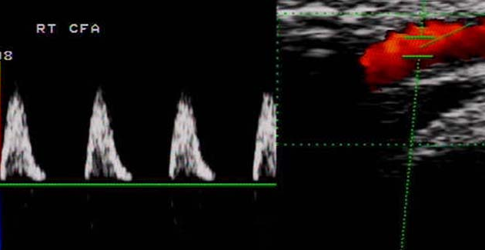
Monophasic Waveform

Slide 33
Spectral Display
Bi-phasic Flow
Flow start on one
side of the Baseline
and then crosses to
the other.
Frequency
Time
Notes:
Spectral Doppler Modes
Pulsed Wave Doppler
Continuous Wave Doppler (with cardiac option)
In Pulsed Wave and Continuous Wave Doppler, you select the area of interest by positioning a Doppler cursor within the 2-D image. Pulsed Wave Doppler displays velocities within the range bounded by the Doppler gate on the cursor. Both let you simultaneously display the 2-D image and Doppler spectral information or independently display spectral Doppler information.
Auxiliary Continuous Wave Doppler (with cardiac option)
Auxiliary Continuous Wave Doppler uses a special auxiliary transducer. Because of its small size, the auxiliary transducer can access any area requiring documentation of blood flow. You position the auxiliary transducer independently of the transducer you are using for the 2-D image. Auxiliary Continuous Wave Doppler displays only a full-screen spectral display.
HPRF (High Pulse Repetition Frequency)
High Pulse Repetition Frequency (HPRF) allows increased velocity detection at depth and localization of flow. Use HPRF Pulsed Doppler mode when you want the Doppler velocity scale higher than the system can provide in standard Pulsed Doppler mode at a specific gate depth. HPRF generates multiple sample volumes displayed with smaller secondary gates in addition to the standard gate size of the primary sample volume. Excellent Sensitivity.

Slide 34
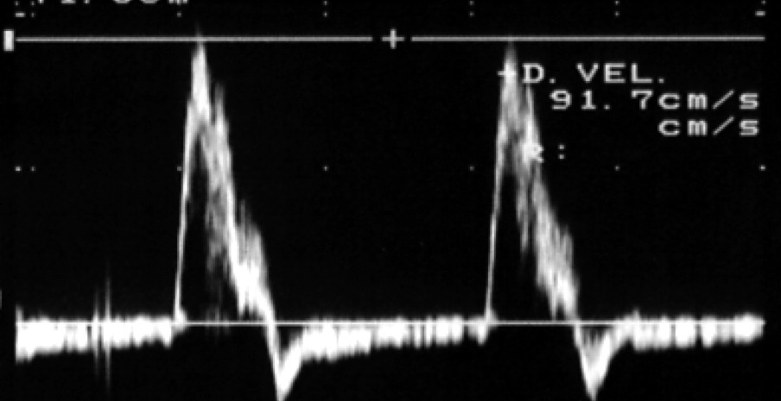
Biphasic Waveform

Slide 35
Spectral Display
Tri-phasic Flow
Flow starts on one side
of the baseline, then crosses to the other, then returns to
the original side.
Frequency
Time
Notes:
Spectral Doppler Modes
Pulsed Wave Doppler
Continuous Wave Doppler (with cardiac option)
In Pulsed Wave and Continuous Wave Doppler, you select the area of interest by positioning a Doppler cursor within the 2-D image. Pulsed Wave Doppler displays velocities within the range bounded by the Doppler gate on the cursor. Both let you simultaneously display the 2-D image and Doppler spectral information or independently display spectral Doppler information.
Auxiliary Continuous Wave Doppler (with cardiac option)
Auxiliary Continuous Wave Doppler uses a special auxiliary transducer. Because of its small size, the auxiliary transducer can access any area requiring documentation of blood flow. You position the auxiliary transducer independently of the transducer you are using for the 2-D image. Auxiliary Continuous Wave Doppler displays only a full-screen spectral display.
HPRF (High Pulse Repetition Frequency)
High Pulse Repetition Frequency (HPRF) allows increased velocity detection at depth and localization of flow. Use HPRF Pulsed Doppler mode when you want the Doppler velocity scale higher than the system can provide in standard Pulsed Doppler mode at a specific gate depth. HPRF generates multiple sample volumes displayed with smaller secondary gates in addition to the standard gate size of the primary sample volume. Excellent Sensitivity.

Slide 36
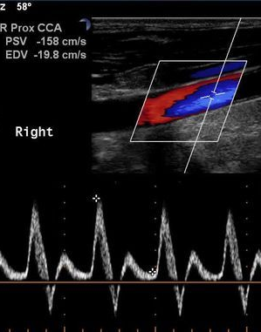
Triphasic Waveform

Slide 37
Spectral Display
Bidirectional Flow
Flow which occurs
simultaneously on
both sides of the
baseline.
Frequency
Time
Notes:
Spectral Doppler Modes
Pulsed Wave Doppler
Continuous Wave Doppler (with cardiac option)
In Pulsed Wave and Continuous Wave Doppler, you select the area of interest by positioning a Doppler cursor within the 2-D image. Pulsed Wave Doppler displays velocities within the range bounded by the Doppler gate on the cursor. Both let you simultaneously display the 2-D image and Doppler spectral information or independently display spectral Doppler information.
Auxiliary Continuous Wave Doppler (with cardiac option)
Auxiliary Continuous Wave Doppler uses a special auxiliary transducer. Because of its small size, the auxiliary transducer can access any area requiring documentation of blood flow. You position the auxiliary transducer independently of the transducer you are using for the 2-D image. Auxiliary Continuous Wave Doppler displays only a full-screen spectral display.
HPRF (High Pulse Repetition Frequency)
High Pulse Repetition Frequency (HPRF) allows increased velocity detection at depth and localization of flow. Use HPRF Pulsed Doppler mode when you want the Doppler velocity scale higher than the system can provide in standard Pulsed Doppler mode at a specific gate depth. HPRF generates multiple sample volumes displayed with smaller secondary gates in addition to the standard gate size of the primary sample volume. Excellent Sensitivity.

Slide 38
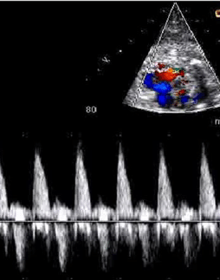
Bi-directional flow

Slide 39
Doppler Spectrum Assessment
Amplitude
The spectrum displays echo amplitude by varying the brightness of the display.
The amplitude of the echoes are determined by:
Echo intensity
Power
Gain
Dynamic range
Notes:
Spectral Doppler Modes
Pulsed Wave Doppler
Continuous Wave Doppler (with cardiac option)
In Pulsed Wave and Continuous Wave Doppler, you select the area of interest by positioning a Doppler cursor within the 2-D image. Pulsed Wave Doppler displays velocities within the range bounded by the Doppler gate on the cursor. Both let you simultaneously display the 2-D image and Doppler spectral information or independently display spectral Doppler information.
Auxiliary Continuous Wave Doppler (with cardiac option)
Auxiliary Continuous Wave Doppler uses a special auxiliary transducer. Because of its small size, the auxiliary transducer can access any area requiring documentation of blood flow. You position the auxiliary transducer independently of the transducer you are using for the 2-D image. Auxiliary Continuous Wave Doppler displays only a full-screen spectral display.
HPRF (High Pulse Repetition Frequency)
High Pulse Repetition Frequency (HPRF) allows increased velocity detection at depth and localization of flow. Use HPRF Pulsed Doppler mode when you want the Doppler velocity scale higher than the system can provide in standard Pulsed Doppler mode at a specific gate depth. HPRF generates multiple sample volumes displayed with smaller secondary gates in addition to the standard gate size of the primary sample volume. Excellent Sensitivity.

Slide 40
Spectral Display
Low amplitude
Frequency
Time
Notes:
Spectral Doppler Modes
Pulsed Wave Doppler
Continuous Wave Doppler (with cardiac option)
In Pulsed Wave and Continuous Wave Doppler, you select the area of interest by positioning a Doppler cursor within the 2-D image. Pulsed Wave Doppler displays velocities within the range bounded by the Doppler gate on the cursor. Both let you simultaneously display the 2-D image and Doppler spectral information or independently display spectral Doppler information.
Auxiliary Continuous Wave Doppler (with cardiac option)
Auxiliary Continuous Wave Doppler uses a special auxiliary transducer. Because of its small size, the auxiliary transducer can access any area requiring documentation of blood flow. You position the auxiliary transducer independently of the transducer you are using for the 2-D image. Auxiliary Continuous Wave Doppler displays only a full-screen spectral display.
HPRF (High Pulse Repetition Frequency)
High Pulse Repetition Frequency (HPRF) allows increased velocity detection at depth and localization of flow. Use HPRF Pulsed Doppler mode when you want the Doppler velocity scale higher than the system can provide in standard Pulsed Doppler mode at a specific gate depth. HPRF generates multiple sample volumes displayed with smaller secondary gates in addition to the standard gate size of the primary sample volume. Excellent Sensitivity.

Slide 41
Spectral Display
Mid amplitude
Frequency
Time
Notes:
Spectral Doppler Modes
Pulsed Wave Doppler
Continuous Wave Doppler (with cardiac option)
In Pulsed Wave and Continuous Wave Doppler, you select the area of interest by positioning a Doppler cursor within the 2-D image. Pulsed Wave Doppler displays velocities within the range bounded by the Doppler gate on the cursor. Both let you simultaneously display the 2-D image and Doppler spectral information or independently display spectral Doppler information.
Auxiliary Continuous Wave Doppler (with cardiac option)
Auxiliary Continuous Wave Doppler uses a special auxiliary transducer. Because of its small size, the auxiliary transducer can access any area requiring documentation of blood flow. You position the auxiliary transducer independently of the transducer you are using for the 2-D image. Auxiliary Continuous Wave Doppler displays only a full-screen spectral display.
HPRF (High Pulse Repetition Frequency)
High Pulse Repetition Frequency (HPRF) allows increased velocity detection at depth and localization of flow. Use HPRF Pulsed Doppler mode when you want the Doppler velocity scale higher than the system can provide in standard Pulsed Doppler mode at a specific gate depth. HPRF generates multiple sample volumes displayed with smaller secondary gates in addition to the standard gate size of the primary sample volume. Excellent Sensitivity.

Slide 42
Spectral Display
High amplitude
Frequency
Time
Notes:
Spectral Doppler Modes
Pulsed Wave Doppler
Continuous Wave Doppler (with cardiac option)
In Pulsed Wave and Continuous Wave Doppler, you select the area of interest by positioning a Doppler cursor within the 2-D image. Pulsed Wave Doppler displays velocities within the range bounded by the Doppler gate on the cursor. Both let you simultaneously display the 2-D image and Doppler spectral information or independently display spectral Doppler information.
Auxiliary Continuous Wave Doppler (with cardiac option)
Auxiliary Continuous Wave Doppler uses a special auxiliary transducer. Because of its small size, the auxiliary transducer can access any area requiring documentation of blood flow. You position the auxiliary transducer independently of the transducer you are using for the 2-D image. Auxiliary Continuous Wave Doppler displays only a full-screen spectral display.
HPRF (High Pulse Repetition Frequency)
High Pulse Repetition Frequency (HPRF) allows increased velocity detection at depth and localization of flow. Use HPRF Pulsed Doppler mode when you want the Doppler velocity scale higher than the system can provide in standard Pulsed Doppler mode at a specific gate depth. HPRF generates multiple sample volumes displayed with smaller secondary gates in addition to the standard gate size of the primary sample volume. Excellent Sensitivity.

Slide 43
Doppler Spectrum Assessment
Window
Received Doppler shift consists of a range of frequencies.
Narrow range of frequencies will result in a narrow display line.
The clear area underneath the spectrum is called the window.
Notes:
Spectral Doppler Modes
Pulsed Wave Doppler
Continuous Wave Doppler (with cardiac option)
In Pulsed Wave and Continuous Wave Doppler, you select the area of interest by positioning a Doppler cursor within the 2-D image. Pulsed Wave Doppler displays velocities within the range bounded by the Doppler gate on the cursor. Both let you simultaneously display the 2-D image and Doppler spectral information or independently display spectral Doppler information.
Auxiliary Continuous Wave Doppler (with cardiac option)
Auxiliary Continuous Wave Doppler uses a special auxiliary transducer. Because of its small size, the auxiliary transducer can access any area requiring documentation of blood flow. You position the auxiliary transducer independently of the transducer you are using for the 2-D image. Auxiliary Continuous Wave Doppler displays only a full-screen spectral display.
HPRF (High Pulse Repetition Frequency)
High Pulse Repetition Frequency (HPRF) allows increased velocity detection at depth and localization of flow. Use HPRF Pulsed Doppler mode when you want the Doppler velocity scale higher than the system can provide in standard Pulsed Doppler mode at a specific gate depth. HPRF generates multiple sample volumes displayed with smaller secondary gates in addition to the standard gate size of the primary sample volume. Excellent Sensitivity.

Slide 44
Spectral Display
Velocity
A narrow range of frequencies
results in large clear window.
Sonic Window
Time
Notes:
Spectral Doppler Modes
Pulsed Wave Doppler
Continuous Wave Doppler (with cardiac option)
In Pulsed Wave and Continuous Wave Doppler, you select the area of interest by positioning a Doppler cursor within the 2-D image. Pulsed Wave Doppler displays velocities within the range bounded by the Doppler gate on the cursor. Both let you simultaneously display the 2-D image and Doppler spectral information or independently display spectral Doppler information.
Auxiliary Continuous Wave Doppler (with cardiac option)
Auxiliary Continuous Wave Doppler uses a special auxiliary transducer. Because of its small size, the auxiliary transducer can access any area requiring documentation of blood flow. You position the auxiliary transducer independently of the transducer you are using for the 2-D image. Auxiliary Continuous Wave Doppler displays only a full-screen spectral display.
HPRF (High Pulse Repetition Frequency)
High Pulse Repetition Frequency (HPRF) allows increased velocity detection at depth and localization of flow. Use HPRF Pulsed Doppler mode when you want the Doppler velocity scale higher than the system can provide in standard Pulsed Doppler mode at a specific gate depth. HPRF generates multiple sample volumes displayed with smaller secondary gates in addition to the standard gate size of the primary sample volume. Excellent Sensitivity.

Slide 45
Spectral Display
Velocity
A broad range of frequencies
results in diminished window.
Sonic Window
Time
Notes:
Spectral Doppler Modes
Pulsed Wave Doppler
Continuous Wave Doppler (with cardiac option)
In Pulsed Wave and Continuous Wave Doppler, you select the area of interest by positioning a Doppler cursor within the 2-D image. Pulsed Wave Doppler displays velocities within the range bounded by the Doppler gate on the cursor. Both let you simultaneously display the 2-D image and Doppler spectral information or independently display spectral Doppler information.
Auxiliary Continuous Wave Doppler (with cardiac option)
Auxiliary Continuous Wave Doppler uses a special auxiliary transducer. Because of its small size, the auxiliary transducer can access any area requiring documentation of blood flow. You position the auxiliary transducer independently of the transducer you are using for the 2-D image. Auxiliary Continuous Wave Doppler displays only a full-screen spectral display.
HPRF (High Pulse Repetition Frequency)
High Pulse Repetition Frequency (HPRF) allows increased velocity detection at depth and localization of flow. Use HPRF Pulsed Doppler mode when you want the Doppler velocity scale higher than the system can provide in standard Pulsed Doppler mode at a specific gate depth. HPRF generates multiple sample volumes displayed with smaller secondary gates in addition to the standard gate size of the primary sample volume. Excellent Sensitivity.

Slide 46
Spectral Broadening
Loss of the spectral window is called spectral broadening
Occurs usually:
As the blood decelerates in diastole
If sample volume is placed too close to the vessel wall
In small vessels (parabolic velocity profile)
Notes:
Spectral Doppler Modes
Pulsed Wave Doppler
Continuous Wave Doppler (with cardiac option)
In Pulsed Wave and Continuous Wave Doppler, you select the area of interest by positioning a Doppler cursor within the 2-D image. Pulsed Wave Doppler displays velocities within the range bounded by the Doppler gate on the cursor. Both let you simultaneously display the 2-D image and Doppler spectral information or independently display spectral Doppler information.
Auxiliary Continuous Wave Doppler (with cardiac option)
Auxiliary Continuous Wave Doppler uses a special auxiliary transducer. Because of its small size, the auxiliary transducer can access any area requiring documentation of blood flow. You position the auxiliary transducer independently of the transducer you are using for the 2-D image. Auxiliary Continuous Wave Doppler displays only a full-screen spectral display.
HPRF (High Pulse Repetition Frequency)
High Pulse Repetition Frequency (HPRF) allows increased velocity detection at depth and localization of flow. Use HPRF Pulsed Doppler mode when you want the Doppler velocity scale higher than the system can provide in standard Pulsed Doppler mode at a specific gate depth. HPRF generates multiple sample volumes displayed with smaller secondary gates in addition to the standard gate size of the primary sample volume. Excellent Sensitivity.

Slide 47
Spectral Broadening
Tortuous vessels
Low flow states
Excessive gain/power/dynamic range
Notes:
Spectral Doppler Modes
Pulsed Wave Doppler
Continuous Wave Doppler (with cardiac option)
In Pulsed Wave and Continuous Wave Doppler, you select the area of interest by positioning a Doppler cursor within the 2-D image. Pulsed Wave Doppler displays velocities within the range bounded by the Doppler gate on the cursor. Both let you simultaneously display the 2-D image and Doppler spectral information or independently display spectral Doppler information.
Auxiliary Continuous Wave Doppler (with cardiac option)
Auxiliary Continuous Wave Doppler uses a special auxiliary transducer. Because of its small size, the auxiliary transducer can access any area requiring documentation of blood flow. You position the auxiliary transducer independently of the transducer you are using for the 2-D image. Auxiliary Continuous Wave Doppler displays only a full-screen spectral display.
HPRF (High Pulse Repetition Frequency)
High Pulse Repetition Frequency (HPRF) allows increased velocity detection at depth and localization of flow. Use HPRF Pulsed Doppler mode when you want the Doppler velocity scale higher than the system can provide in standard Pulsed Doppler mode at a specific gate depth. HPRF generates multiple sample volumes displayed with smaller secondary gates in addition to the standard gate size of the primary sample volume. Excellent Sensitivity.

Slide 48
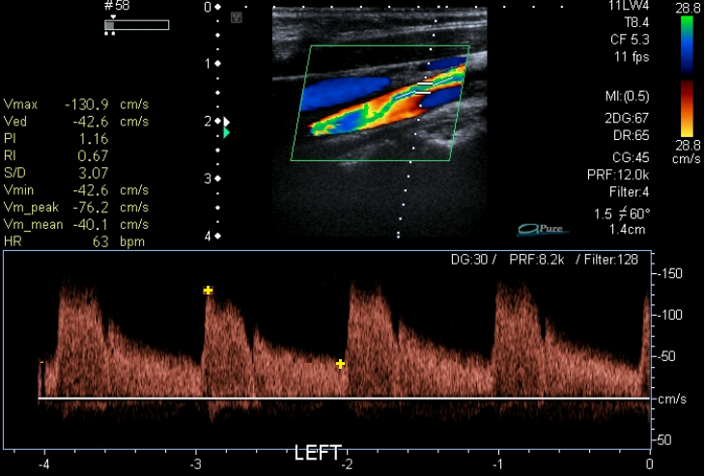
Spectral Broadening
It is hallmark of disturbed and/or
turbulent flow.
Notes:
Spectral Doppler Modes
Pulsed Wave Doppler
Continuous Wave Doppler (with cardiac option)
In Pulsed Wave and Continuous Wave Doppler, you select the area of interest by positioning a Doppler cursor within the 2-D image. Pulsed Wave Doppler displays velocities within the range bounded by the Doppler gate on the cursor. Both let you simultaneously display the 2-D image and Doppler spectral information or independently display spectral Doppler information.
Auxiliary Continuous Wave Doppler (with cardiac option)
Auxiliary Continuous Wave Doppler uses a special auxiliary transducer. Because of its small size, the auxiliary transducer can access any area requiring documentation of blood flow. You position the auxiliary transducer independently of the transducer you are using for the 2-D image. Auxiliary Continuous Wave Doppler displays only a full-screen spectral display.
HPRF (High Pulse Repetition Frequency)
High Pulse Repetition Frequency (HPRF) allows increased velocity detection at depth and localization of flow. Use HPRF Pulsed Doppler mode when you want the Doppler velocity scale higher than the system can provide in standard Pulsed Doppler mode at a specific gate depth. HPRF generates multiple sample volumes displayed with smaller secondary gates in addition to the standard gate size of the primary sample volume. Excellent Sensitivity.

Slide 49
Spectral Display
Maximum
Velocity
Pulsatility Index
PI = Max – Min
Mean
Frequency
Mean Velocity
Minimum Velocity
Time
Notes:
Spectral Doppler Modes
Pulsed Wave Doppler
Continuous Wave Doppler (with cardiac option)
In Pulsed Wave and Continuous Wave Doppler, you select the area of interest by positioning a Doppler cursor within the 2-D image. Pulsed Wave Doppler displays velocities within the range bounded by the Doppler gate on the cursor. Both let you simultaneously display the 2-D image and Doppler spectral information or independently display spectral Doppler information.
Auxiliary Continuous Wave Doppler (with cardiac option)
Auxiliary Continuous Wave Doppler uses a special auxiliary transducer. Because of its small size, the auxiliary transducer can access any area requiring documentation of blood flow. You position the auxiliary transducer independently of the transducer you are using for the 2-D image. Auxiliary Continuous Wave Doppler displays only a full-screen spectral display.
HPRF (High Pulse Repetition Frequency)
High Pulse Repetition Frequency (HPRF) allows increased velocity detection at depth and localization of flow. Use HPRF Pulsed Doppler mode when you want the Doppler velocity scale higher than the system can provide in standard Pulsed Doppler mode at a specific gate depth. HPRF generates multiple sample volumes displayed with smaller secondary gates in addition to the standard gate size of the primary sample volume. Excellent Sensitivity.

Slide 50
Spectral Analysis Parameters
Sample volume
Center SV in center of vessel to avoid spectral broadening

Slide 51
Spectral Analysis Parameters
Sample volume size
Start with a large sample volume to improve sensitivity
Decrease SV to reduce spectral broadening once flow is established

Slide 52
Spectral Analysis Parameters
Gain
Increase gain to improve
sensitivity.
Once flow is established decrease
gain
Excess gain will cause spectral
broadening and mirroring.
Notes:
Spectral Doppler Modes
Pulsed Wave Doppler
Continuous Wave Doppler (with cardiac option)
In Pulsed Wave and Continuous Wave Doppler, you select the area of interest by positioning a Doppler cursor within the 2-D image. Pulsed Wave Doppler displays velocities within the range bounded by the Doppler gate on the cursor. Both let you simultaneously display the 2-D image and Doppler spectral information or independently display spectral Doppler information.
Auxiliary Continuous Wave Doppler (with cardiac option)
Auxiliary Continuous Wave Doppler uses a special auxiliary transducer. Because of its small size, the auxiliary transducer can access any area requiring documentation of blood flow. You position the auxiliary transducer independently of the transducer you are using for the 2-D image. Auxiliary Continuous Wave Doppler displays only a full-screen spectral display.
HPRF (High Pulse Repetition Frequency)
High Pulse Repetition Frequency (HPRF) allows increased velocity detection at depth and localization of flow. Use HPRF Pulsed Doppler mode when you want the Doppler velocity scale higher than the system can provide in standard Pulsed Doppler mode at a specific gate depth. HPRF generates multiple sample volumes displayed with smaller secondary gates in addition to the standard gate size of the primary sample volume. Excellent Sensitivity.

Slide 53
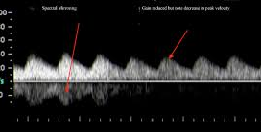
Increased Gain

Slide 54
Spectral Analysis Parameters
Baseline
Center baseline initially when searching for
flow.
Once direction is established, shift to optimize
display.
Notes:
Spectral Doppler Modes
Pulsed Wave Doppler
Continuous Wave Doppler (with cardiac option)
In Pulsed Wave and Continuous Wave Doppler, you select the area of interest by positioning a Doppler cursor within the 2-D image. Pulsed Wave Doppler displays velocities within the range bounded by the Doppler gate on the cursor. Both let you simultaneously display the 2-D image and Doppler spectral information or independently display spectral Doppler information.
Auxiliary Continuous Wave Doppler (with cardiac option)
Auxiliary Continuous Wave Doppler uses a special auxiliary transducer. Because of its small size, the auxiliary transducer can access any area requiring documentation of blood flow. You position the auxiliary transducer independently of the transducer you are using for the 2-D image. Auxiliary Continuous Wave Doppler displays only a full-screen spectral display.
HPRF (High Pulse Repetition Frequency)
High Pulse Repetition Frequency (HPRF) allows increased velocity detection at depth and localization of flow. Use HPRF Pulsed Doppler mode when you want the Doppler velocity scale higher than the system can provide in standard Pulsed Doppler mode at a specific gate depth. HPRF generates multiple sample volumes displayed with smaller secondary gates in addition to the standard gate size of the primary sample volume. Excellent Sensitivity.

Slide 55
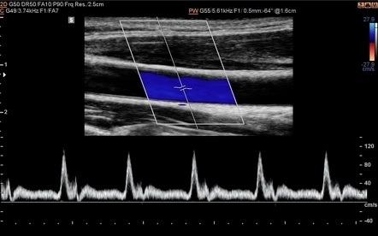
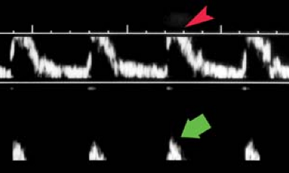
Baseline

Slide 56
Spectral Analysis Parameters
Sweep Speed
Changes the length of time displayed on
X-axis of the spectral display.
Set sweep speed should be set to allow
display of several cardiac cycles at a time.
Notes:
Spectral Doppler Modes
Pulsed Wave Doppler
Continuous Wave Doppler (with cardiac option)
In Pulsed Wave and Continuous Wave Doppler, you select the area of interest by positioning a Doppler cursor within the 2-D image. Pulsed Wave Doppler displays velocities within the range bounded by the Doppler gate on the cursor. Both let you simultaneously display the 2-D image and Doppler spectral information or independently display spectral Doppler information.
Auxiliary Continuous Wave Doppler (with cardiac option)
Auxiliary Continuous Wave Doppler uses a special auxiliary transducer. Because of its small size, the auxiliary transducer can access any area requiring documentation of blood flow. You position the auxiliary transducer independently of the transducer you are using for the 2-D image. Auxiliary Continuous Wave Doppler displays only a full-screen spectral display.
HPRF (High Pulse Repetition Frequency)
High Pulse Repetition Frequency (HPRF) allows increased velocity detection at depth and localization of flow. Use HPRF Pulsed Doppler mode when you want the Doppler velocity scale higher than the system can provide in standard Pulsed Doppler mode at a specific gate depth. HPRF generates multiple sample volumes displayed with smaller secondary gates in addition to the standard gate size of the primary sample volume. Excellent Sensitivity.

Slide 57
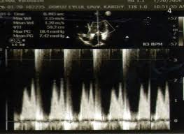
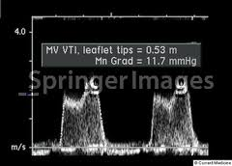
Sweep Speed

Slide 58
Spectral Artifacts
Mirroring
Duplication of the Doppler waveform on the other side of the baseline.
Duplicated waveform is identical in terms of frequency and temporal components.
.
Duplicate image has diminished amplitude.
Notes:
Spectral Doppler Modes
Pulsed Wave Doppler
Continuous Wave Doppler (with cardiac option)
In Pulsed Wave and Continuous Wave Doppler, you select the area of interest by positioning a Doppler cursor within the 2-D image. Pulsed Wave Doppler displays velocities within the range bounded by the Doppler gate on the cursor. Both let you simultaneously display the 2-D image and Doppler spectral information or independently display spectral Doppler information.
Auxiliary Continuous Wave Doppler (with cardiac option)
Auxiliary Continuous Wave Doppler uses a special auxiliary transducer. Because of its small size, the auxiliary transducer can access any area requiring documentation of blood flow. You position the auxiliary transducer independently of the transducer you are using for the 2-D image. Auxiliary Continuous Wave Doppler displays only a full-screen spectral display.
HPRF (High Pulse Repetition Frequency)
High Pulse Repetition Frequency (HPRF) allows increased velocity detection at depth and localization of flow. Use HPRF Pulsed Doppler mode when you want the Doppler velocity scale higher than the system can provide in standard Pulsed Doppler mode at a specific gate depth. HPRF generates multiple sample volumes displayed with smaller secondary gates in addition to the standard gate size of the primary sample volume. Excellent Sensitivity.

Slide 59
Spectral Artifact
Mirroring
Frequency
Time
Notes:
Spectral Doppler Modes
Pulsed Wave Doppler
Continuous Wave Doppler (with cardiac option)
In Pulsed Wave and Continuous Wave Doppler, you select the area of interest by positioning a Doppler cursor within the 2-D image. Pulsed Wave Doppler displays velocities within the range bounded by the Doppler gate on the cursor. Both let you simultaneously display the 2-D image and Doppler spectral information or independently display spectral Doppler information.
Auxiliary Continuous Wave Doppler (with cardiac option)
Auxiliary Continuous Wave Doppler uses a special auxiliary transducer. Because of its small size, the auxiliary transducer can access any area requiring documentation of blood flow. You position the auxiliary transducer independently of the transducer you are using for the 2-D image. Auxiliary Continuous Wave Doppler displays only a full-screen spectral display.
HPRF (High Pulse Repetition Frequency)
High Pulse Repetition Frequency (HPRF) allows increased velocity detection at depth and localization of flow. Use HPRF Pulsed Doppler mode when you want the Doppler velocity scale higher than the system can provide in standard Pulsed Doppler mode at a specific gate depth. HPRF generates multiple sample volumes displayed with smaller secondary gates in addition to the standard gate size of the primary sample volume. Excellent Sensitivity.

Slide 60
Spectral Artifacts
Causes of mirroring
Doppler angle close to 90 degrees.
Excessive gain.
Notes:
Spectral Doppler Modes
Pulsed Wave Doppler
Continuous Wave Doppler (with cardiac option)
In Pulsed Wave and Continuous Wave Doppler, you select the area of interest by positioning a Doppler cursor within the 2-D image. Pulsed Wave Doppler displays velocities within the range bounded by the Doppler gate on the cursor. Both let you simultaneously display the 2-D image and Doppler spectral information or independently display spectral Doppler information.
Auxiliary Continuous Wave Doppler (with cardiac option)
Auxiliary Continuous Wave Doppler uses a special auxiliary transducer. Because of its small size, the auxiliary transducer can access any area requiring documentation of blood flow. You position the auxiliary transducer independently of the transducer you are using for the 2-D image. Auxiliary Continuous Wave Doppler displays only a full-screen spectral display.
HPRF (High Pulse Repetition Frequency)
High Pulse Repetition Frequency (HPRF) allows increased velocity detection at depth and localization of flow. Use HPRF Pulsed Doppler mode when you want the Doppler velocity scale higher than the system can provide in standard Pulsed Doppler mode at a specific gate depth. HPRF generates multiple sample volumes displayed with smaller secondary gates in addition to the standard gate size of the primary sample volume. Excellent Sensitivity.

Slide 61
Spectral Artifacts
Excessive gain
The quadrature phase detector has two channels.
Each channel is sensitive to the amplitude of the incoming signal.
High Doppler gain will saturate the quadrature detector causing cross talk between the two channels.
Notes:
Spectral Doppler Modes
Pulsed Wave Doppler
Continuous Wave Doppler (with cardiac option)
In Pulsed Wave and Continuous Wave Doppler, you select the area of interest by positioning a Doppler cursor within the 2-D image. Pulsed Wave Doppler displays velocities within the range bounded by the Doppler gate on the cursor. Both let you simultaneously display the 2-D image and Doppler spectral information or independently display spectral Doppler information.
Auxiliary Continuous Wave Doppler (with cardiac option)
Auxiliary Continuous Wave Doppler uses a special auxiliary transducer. Because of its small size, the auxiliary transducer can access any area requiring documentation of blood flow. You position the auxiliary transducer independently of the transducer you are using for the 2-D image. Auxiliary Continuous Wave Doppler displays only a full-screen spectral display.
HPRF (High Pulse Repetition Frequency)
High Pulse Repetition Frequency (HPRF) allows increased velocity detection at depth and localization of flow. Use HPRF Pulsed Doppler mode when you want the Doppler velocity scale higher than the system can provide in standard Pulsed Doppler mode at a specific gate depth. HPRF generates multiple sample volumes displayed with smaller secondary gates in addition to the standard gate size of the primary sample volume. Excellent Sensitivity.

Slide 62
Spectral Artifacts
Aliasing
Pulsed Doppler has a limit to the maximum Doppler shift frequency that can be sampled unambiguously.
This limit is called the Nyquist Limit.
The Nyquist Limit = PRF/2
Notes:
Spectral Doppler Modes
Pulsed Wave Doppler
Continuous Wave Doppler (with cardiac option)
In Pulsed Wave and Continuous Wave Doppler, you select the area of interest by positioning a Doppler cursor within the 2-D image. Pulsed Wave Doppler displays velocities within the range bounded by the Doppler gate on the cursor. Both let you simultaneously display the 2-D image and Doppler spectral information or independently display spectral Doppler information.
Auxiliary Continuous Wave Doppler (with cardiac option)
Auxiliary Continuous Wave Doppler uses a special auxiliary transducer. Because of its small size, the auxiliary transducer can access any area requiring documentation of blood flow. You position the auxiliary transducer independently of the transducer you are using for the 2-D image. Auxiliary Continuous Wave Doppler displays only a full-screen spectral display.
HPRF (High Pulse Repetition Frequency)
High Pulse Repetition Frequency (HPRF) allows increased velocity detection at depth and localization of flow. Use HPRF Pulsed Doppler mode when you want the Doppler velocity scale higher than the system can provide in standard Pulsed Doppler mode at a specific gate depth. HPRF generates multiple sample volumes displayed with smaller secondary gates in addition to the standard gate size of the primary sample volume. Excellent Sensitivity.

Slide 63
Spectral Artifacts
Aliasing
Aliasing only occurs when the Doppler shifts exceed the Nyquist limit. To correct aliasing you can either:
1. Raise the Nyquist Limit
2. Lower the Doppler Shift.
Notes:
Spectral Doppler Modes
Pulsed Wave Doppler
Continuous Wave Doppler (with cardiac option)
In Pulsed Wave and Continuous Wave Doppler, you select the area of interest by positioning a Doppler cursor within the 2-D image. Pulsed Wave Doppler displays velocities within the range bounded by the Doppler gate on the cursor. Both let you simultaneously display the 2-D image and Doppler spectral information or independently display spectral Doppler information.
Auxiliary Continuous Wave Doppler (with cardiac option)
Auxiliary Continuous Wave Doppler uses a special auxiliary transducer. Because of its small size, the auxiliary transducer can access any area requiring documentation of blood flow. You position the auxiliary transducer independently of the transducer you are using for the 2-D image. Auxiliary Continuous Wave Doppler displays only a full-screen spectral display.
HPRF (High Pulse Repetition Frequency)
High Pulse Repetition Frequency (HPRF) allows increased velocity detection at depth and localization of flow. Use HPRF Pulsed Doppler mode when you want the Doppler velocity scale higher than the system can provide in standard Pulsed Doppler mode at a specific gate depth. HPRF generates multiple sample volumes displayed with smaller secondary gates in addition to the standard gate size of the primary sample volume. Excellent Sensitivity.

Slide 64
CW DOPPLER
Contains two crystals or two sets of crystals.
One for transmitting
One for receiving

Slide 65
CW DOPPLER
The transmit crystal is continuously driven by a voltage generator.
Oscillating frequency of the voltage generator regulates the frequency of the emitted wave.

Slide 66
CW DOPPLER
In the sound beam the transmitted and reflected sound waves overlap over a relatively narrow range.
The region of overlap is called the flow sensitive zone.

Slide 67
CW DOPPLER
Transmitting
Crystal
Flow sensitive Zone
Receiving
Crystal

Slide 68
CW DOPPLER
The flow sensitive zone varies with different transducers.
Low frequency transducers have deep flow sensitive zones
High frequency transducers have superficial flow sensitive zones.

Slide 69
CW DOPPLER
Doppler shift can be located at any depth in the flow sensitive zone of beam.
The Doppler receiver is unable to determine the exact location of the Doppler shift thus CW lacks range resolution
It is continuously sampling returning echoes and has no limitations on measuring high flow velocities.

Slide 70
Color Flow Imaging
Pulsed Doppler Technique
Uses 200 – 500 sample gates along each scan line.
Multiple pulses are sent down each scan line.
The number of pulses that are sent down each scan line is called the Packet Size or Ensemble Length.

Slide 71
Color Flow Imaging
Multiple Pulses
Multiple Gates

Slide 72
Color Flow Imaging
To produce the color flow image, the mean Doppler shift is encoded according to a preset color map.
This color information is superimposed on the gray scale anatomic scan in real time.

Slide 73
Color Flow Maps
Velocity color map
Variance color map

Slide 74
Color Flow Imaging
Velocity Color Map
One color used to encode shift in one channel.
Another color to encode shift in the other channel.
As the Doppler shifts increase, they are assigned lighter shades of these colors.

Slide 75
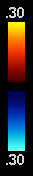
Velocity Color Bar
Increasing flow velocity toward the transducer
Zero flow
Increasing flow velocity away from the transducer
Notes:
Doppler Principles
Color Doppler
Imaging technique
Color Doppler Velocity is an imaging technique, with many sample gates inside the color box. The information derived measures mean velocity and variance within an area of the image.
Color Doppler can be used to evaluate patency, direction and pulsatility. It is also a road map to placement of the Doppler cursor for spectral Doppler analysis of flow.
Best Doppler imaging angle is closest to 0 degrees
...the same as in spectral Doppler. Remember your best 2-D imaging angle is 90 degrees.
Spectral Doppler
Graphic Technique
Displays peak, mean and range of velocities at a single point along the Doppler beam (PW) or along the entire beam (CW)

Slide 76
Aliasing
Color Doppler can alias.
As the Doppler shift increases the color will be encoded with a light shade of one color into the light shade of the other color.

Slide 77
Aliasing
Increasing flow velocity toward the transducer
Wrap Around
Zero flow
Increasing flow velocity away from the transducer
Notes:
Doppler Principles
Color Doppler
Imaging technique
Color Doppler Velocity is an imaging technique, with many sample gates inside the color box. The information derived measures mean velocity and variance within an area of the image.
Color Doppler can be used to evaluate patency, direction and pulsatility. It is also a road map to placement of the Doppler cursor for spectral Doppler analysis of flow.
Best Doppler imaging angle is closest to 0 degrees
...the same as in spectral Doppler. Remember your best 2-D imaging angle is 90 degrees.
Spectral Doppler
Graphic Technique
Displays peak, mean and range of velocities at a single point along the Doppler beam (PW) or along the entire beam (CW)

Slide 78
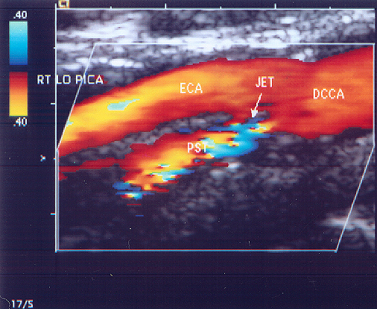
Aliasing
Laminar
Notes:
Color imaging has markedly increased the technical efficacy of the cerebrovascular exam. Advantages include:
The presence, absence, direction, and mean velocity of flow dynamics
Facilitates placement of the sample gate for obtaining quantitative information
Facilitates the identification of various states throughout the image field such as disturbed and turbulent flow, indicated by color aliasing.
Differentiates critical stenosis and occlusion; evidenced by poststenotic turbulence, trickle flow, and color void by using low-scale color imaging
Differentiates vascular from nonvascular structures

Slide 79
Color Flow Imaging
Estimate of mean velocity only
Shows direction of flow by color assignment
Shows changes in mean velocity by changing shades or different color
Notes:
The value of CDV is in the fact that estimated mean velocity can be mapped into color, together with direction of flow information. On the negative side, angle to flow effects and aliasing artifacts can arise that can hide information or create pitfalls in image interpretation.

Slide 80
Color Flow Imaging
Flow is angle dependent
Potential for aliasing artifacts
Notes:
The value of CDV is in the fact that estimated mean velocity can be mapped into color, together with direction of flow information. On the negative side, angle to flow effects and aliasing artifacts can arise that can hide information or create pitfalls in image interpretation.

Slide 81

Other Forms of Doppler
Tissue Doppler
Measures myocardial motion
Power Doppler
Highly sensitive Doppler that can detect lower flow patterns and is not as sensitive to angle

Slide 82
Tissue Doppler Imaging (TDI)
Measures the motion of the Myocardium towards the PW gate
Ap4 chamber interrogating 1 annulus at a time
Used to assess DD (Diastolic Dysfunction) in LV and Systolic Dysfunction in RV

Slide 83
Tissue Doppler Imaging (TDI)
LV: produces E’ and a’ wave below the baseline but only measurement of E’ wave velocity is recorded (lateral and medial/septal annulus)
LV TDI info is compared to MV “E” wave velocity to give us E/E’ (E to E prime).
RV: measurement of S’ wave velocity is recorded from the lateral annulus only (S’ appears above the baseline)

Slide 84
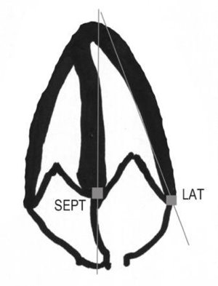
PW gate placement for LV

Slide 85
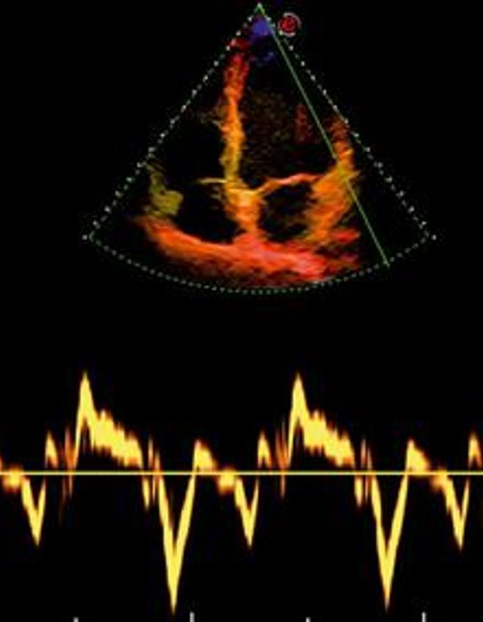
Lateral Annulus

Slide 86
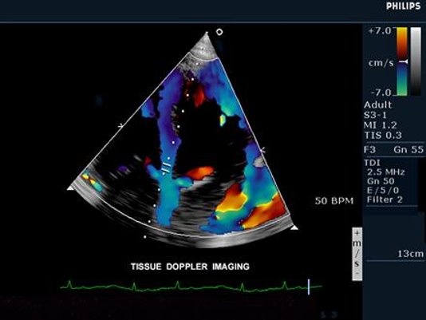
Medial / Septal Annulus

Slide 87
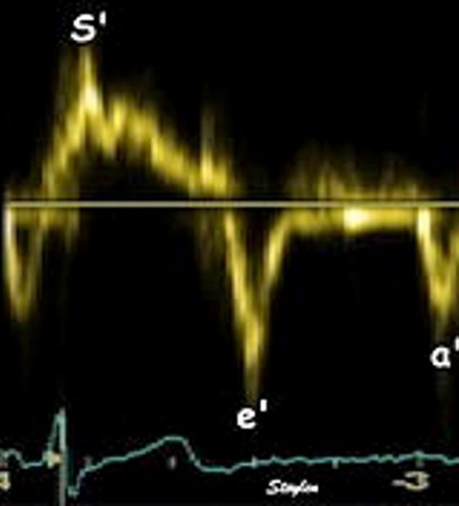
Components of TDI Waveform

Slide 88
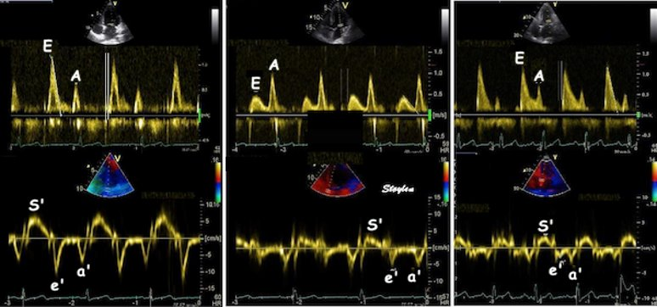
MITRAL PW DOPPLER VS. TISSUE DOPPLER

Slide 89
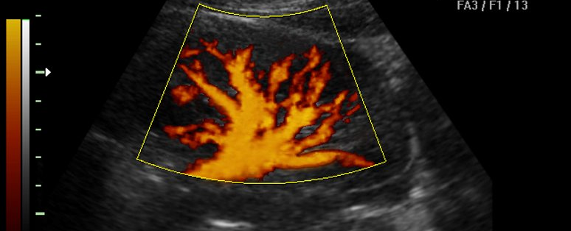
Power Doppler
Highly sensitive Doppler that can detect lower flow patterns and is not as sensitive to angle
Primarily used in vascular ultrasound
Only one color represented
Cannot differentiate b/n flow towards and away from Txr

